Slide 1
Predicting Sleep Disorders based on Lifestyle
Ashton Alonge
Matteo Shafer
Oliver Lane
Notes:
Matteo

Slide 2
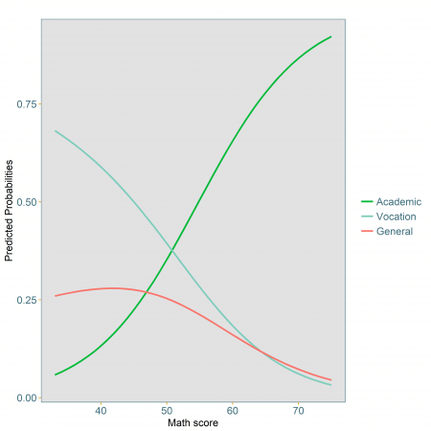
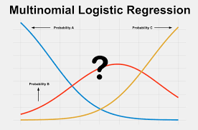
The Algorithm
Multinomial Logistic Regression
Model 1: Sleep Model
Model 2: Physical Activity
Model 3: Stress
Notes:
Logistic regression algorithm

Slide 3

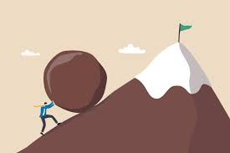
Some issues we ran into early on
Searching for Data
Created KNN Classifier but then realized we had to use spark
Switched to logistic regression, realized it needed to be multinomial logistic regression as we had 3 classes
Notes:
Searching for data finding something that we liked and was interesting, learning the new Breez Library
Found most accurate k, by using a for loop and testing different ks

Slide 4
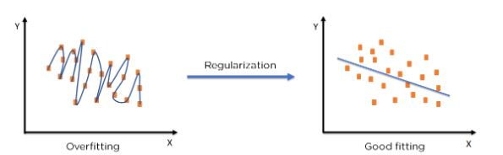
Hyperparameter Tuning
Helps find the best model parameters by comparing performance on different data splits.
Regularization Parameter
Spark ParamGridBuilder()
Notes:
Oli

Slide 5
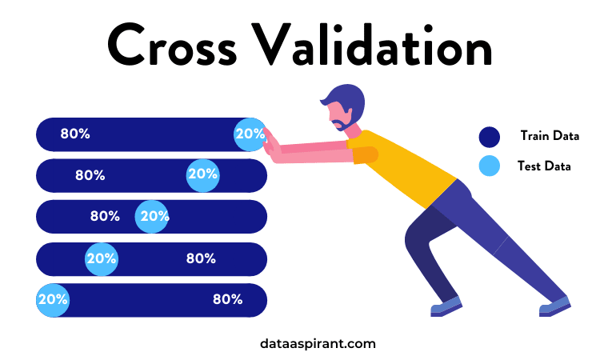
Cross Validation
Cross-validation checks how well a model works on different data to prevent overfitting.
K-fold cross-validation splits data into K parts, trains on K-1 parts, tests on the last part, and repeats K times.
Calculates the accuracies then averages them
Spark handles large datasets efficiently
Compared the accuracy between models
Notes:
Ashton

Slide 6
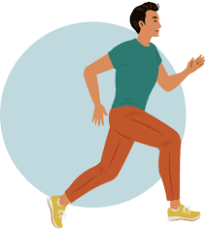
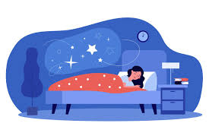
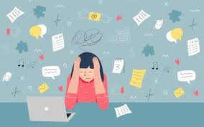
How We Selected the Three Different Models?
Sleep Model Physical Activity Stress
Notes:
Matteo

Slide 7
Model 1: Sleep
Predictors | Accuracy
Sleep Duration Quality of Sleep | 58.0%
Notes:
Ashton

Slide 8
Model 2: Physical Activity
Predictors | Accuracy
Physical Activity Heart Rate Daily Steps | 63.0%
Notes:
Ashton

Slide 9
Model 3: Stress
Predictors | Accuracy
Occupation Stress Level | 88.9%
Notes:
Ashton

Slide 10

Analysis
Stress and occupation are the biggest predictors of sleep disorders
Consistent with studies we found in the National Library of Medicine
Stress inhibits melatonin production and increases risk of sleep disorders
Notes:
Oli

Slide 11
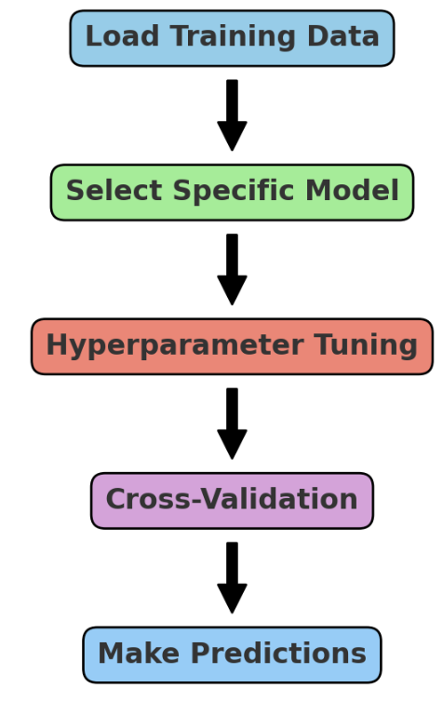

What We learned
Multinomial Logistic Regression
Cross-validation
Hyperparameter tuning
Spark MLlib
Spark Datasets and Structs
Notes:
Oli

Slide 12
Thank You!

